Slide 1
Session Tracking
Huy Pham Ngoc

Slide 2
Session Tracking
URL
Session
Hidden fields
Cookies

Slide 3
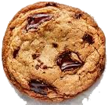
Cookies
First
Client
Server
request
response

Slide 4
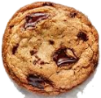
Cookies
> 2
Client
Server
request
response

Slide 5


Session
Session ID
(Jocker)
Container
Session ID
(Batman)

